Slide 1
Advantages and DISADVANTAGES OF INTERNET
Instructor: Ms.HAFSA ZAHRA
Date: 23-03-2020

Slide 2
Advantages of internet
Internet covers almost every aspect of life, one can think of. Here, we will discuss some of the advantages of Internet:
E-mail: E-mail is an online correspondence system. With e-mail you can send and receive instant electronic messages, which works like writing letters. Your messages are delivered instantly to people anywhere in the world, unlike traditional mail that takes a lot of time.
Online Chat: There are many ‘chat rooms’ on the web that can be accessed to meet new people, make new friends, as well as to stay in touch with old friends.

Slide 3
Advantages (Continued)
Shopping: Along with getting information on the Internet, you can also shop online. There are many online stores and sites that can be used to look for products as well as buy them using your credit card. You do not need to leave your house and can do all your shopping from the convenience of your home.
Access Information: The Internet is a virtual treasure trove of information. Any kind of information on any topic under the sun is available on the Internet. The ‘search engines’ on the Internet can help you to find data on any subject that you need.

Slide 4
Advantages (Continued)
Downloading Software: This is one of the most happening and fun things to do via the Internet. You can download innumerable games, music, videos, movies, and a host of other entertainment software from the Internet, most of which are free.
Sharing Information: One can share information with other people around the world. Sharing information through internet is very easy, cheap and a fast method.
Communication: Internet allows us to communicate with the people sitting at remote locations. There are various apps available on the wed that uses Internet as a medium for communication.

Slide 5
Advantages (Continued)
Internet Surfing:
One can surf for any kind of information over the internet. Information regarding various topics such as Technology, Health & Science, Social Studies, Geographical Information, Information Technology, Products etc can be surfed with help of a search engine.
Operates 24 hours, 7 days a week:
You don't need to wait until resources are available to conduct business. From a consumer's perspective as well as a provider's business can be consummated at any time. The fact that the Internet is operational at all times makes it the most efficient business machine to date.

Slide 6
Advantages (Continued)
Apart from communication and source of information, internet also serves a
“Medium for entertainment”.
Following are the various modes for entertainment over internet:
Online television
Online games
Songs
Videos
Social networking apps

Slide 7
Advantages (Continued)
Internet allows us to use many services like:
Internet Banking
Matrimonial Services
Online Shopping
Online Ticket Booking
Online Bill Payment

Slide 8
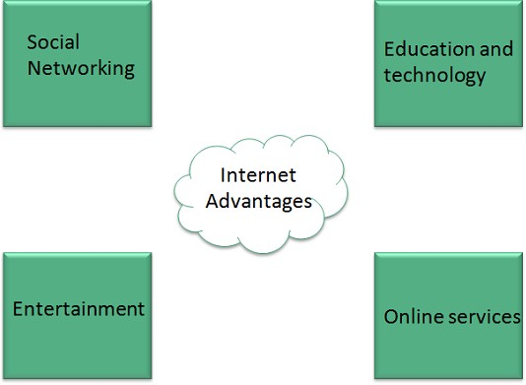
Advantages (Continued)

Slide 9
Disadvantages OF INTERNET
However, Internet has proved to be a powerful source of information in almost every field, yet there exists many disadvantages discussed below:
Personal Information: There are always chances to loose personal information such as name, address, credit card number. Therefore, one should be very careful while sharing such information. One should use credit cards only through authenticated sites.
Spamming: Another disadvantage is the Spamming. Spamming corresponds to the unwanted e-mails in bulk. These e-mails serve no purpose and lead to obstruction of entire system.

Slide 10
Disadvantages (Continued)
Virus: Virus can easily be spread to the computers connected to internet. Such virus attacks may cause your system to crash or your important data may get deleted. Most of the virus transfer from one computer to another through e–mail or when information is downloaded on the internet.
Wastage of Time: Easy to waste a lot of time on the internet. You can start surfing, and then realize far more time has passed than you realized. Internet and television together of added to the more sedentary lifestyles of people which further exacerbates the obesity problem.

Slide 11
Disadvantages (Continued)
Immoral websites: Also a biggest threat on internet is immoral websites . There are many such sites that can be found, letting your children to use internet which indirectly affects the children healthy mental life.
Accuracy of Information: There are various websites that do not provide the authenticated information. This leads to misconception among many people and it becomes difficult to colect the correct information.

Slide 12
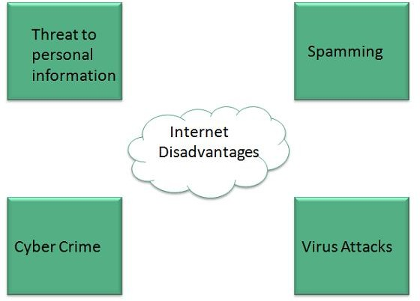
Disadvantages (Continued)

